Slide 1
AML-2304 Natural Language Processing

Slide 2
Introduction
What is your back ground (educational & professional)
Where are you from
What are your ambitions for the future

Slide 3
About Myself
Data Scientist by Passion & Profession
Senior Manager Data Science @ Loblaw
Coauthor & Founding Member : PyCaret
Blogger @ Medium & TowardsDataScience
Facts
Masters in Analytics, Queens University
Chartered Financial Analyst, CFA Institute USA
MBA, IIUI Islamabad
Decision
Information
. Investments
If Fahad can do it , so can I
. Business management
. Datascience

Slide 4
How do I proceed?
I like to keep things simple!
I like to keep things engaging!

Slide 5
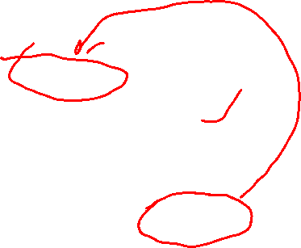
Facts Checks!
Do you have previous Data Science experience?
Do you have a good understanding of Python ?
Do you have a good understanding of SQL ?
Do you have a good understanding of a viz software (e.g. PowerBI etc.)
Yes | No
30% | 70%
70% | 30%
70% | 30%
30% | 70%

Slide 6
Expectations
Data Science:
Training, Validation, Testing, Preprocessing, Feature Engineering , Modeling & Evaluation
Python:
Envs, Libraries, Functions, Classes, Dict, List, For loops, List Comprehension, Pandas

Slide 7
The key concept of Natural Language Processing (NLP)

Slide 8
By the end of class:
Define Natural Language Processing
Describe the Challenges of NLP; extraction of meaning from text
Discuss the importance of Natural Language Processing

Slide 9

Contents
Understanding NLP
NLP Workflow
Applications of NLP
Text Wrangling and Cleaning
Demonstrating Text Preprocessing

Slide 10
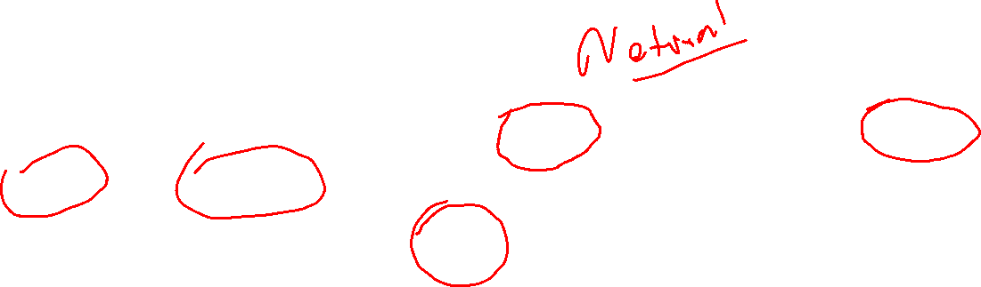
Understanding NLP
Natural Language Processing (NLP) is a subfield of Artificial Intelligence dealing with human natural language and the computerized text’s interactions. NLP is mainly regarding processing and analyzing large amounts of natural language data.

Slide 11
NLP Workflow
Textual Data Collection
Text Preprocessing
Exploratory Data Analysis
Evaluation and Deployment
Modelling or Pattern Mining
Vectorization and Feature Engineering
Text Normalization

Slide 12
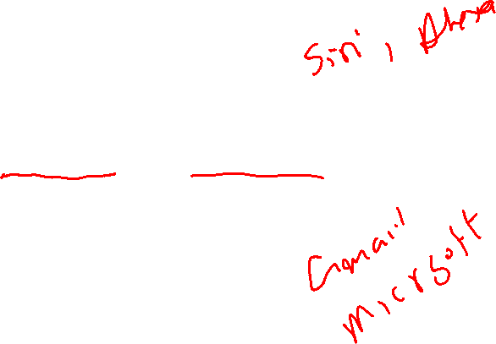
Applications of NLP
1. Chatbots and Virtual assistants:
2. Auto Correct and Auto Complete:

Slide 13

Applications of NLP
Machine Translation:
Predictive analytics and Social Media Monitoring:

Slide 14
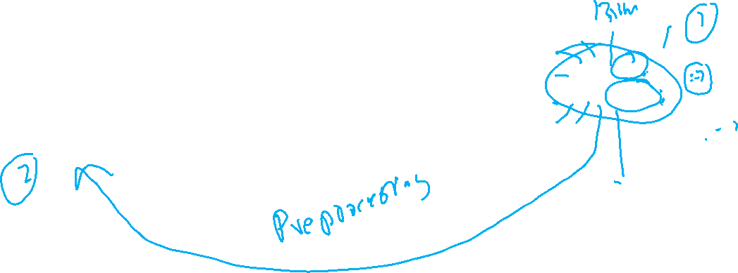
The basic building block of NLP
Day | Temp | Holiday
2 | 22 | 0
3 | 25 | 0
4 | 28 | 1
Ice-cream Sales
22
25
35
I am sad
I am happy

Slide 15
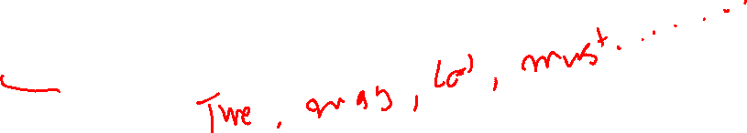
Text Wrangling and Cleaning
Removal of Stop Words:

Slide 16
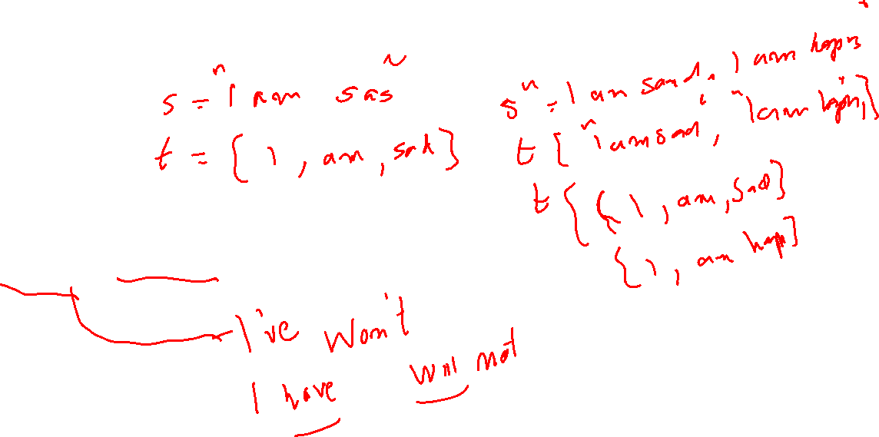
Text Wrangling and Cleaning
Tokenization:
Expanding Contractions:

Slide 17
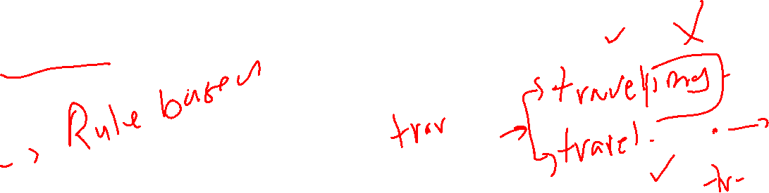
Text Wrangling and Cleaning
Stemming:

Slide 18
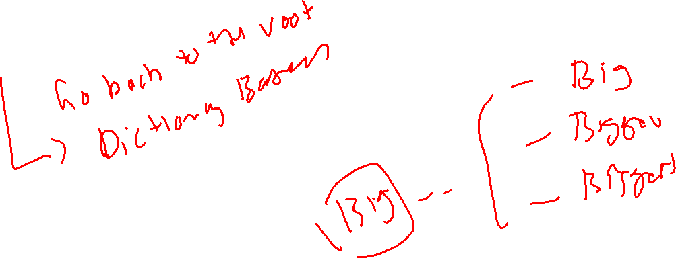
Text Wrangling and Cleaning
Lemmatization:

Slide 19
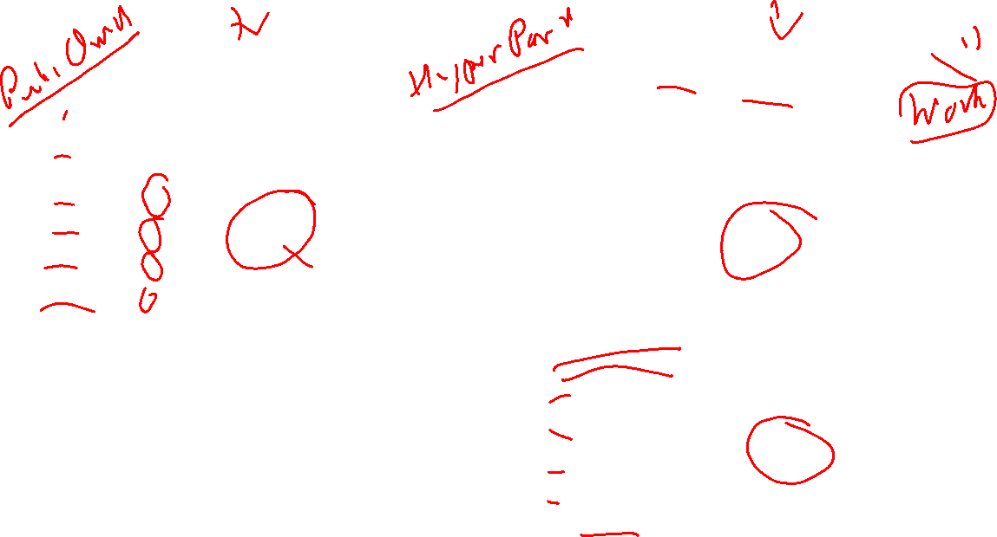
Stemming
Lemmatization
Change
Changing
Changes Chang
Changed
Changer
Change
Changing
Changes Change
Changed
Changer
Develop
Developed
Developing
Development
Drive
Drives
Drove
Driven
develop
drive

Slide 20
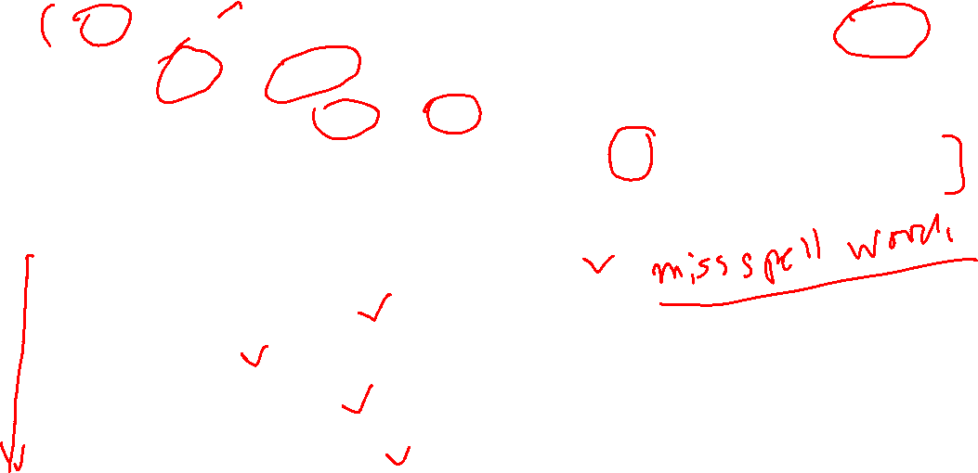
Demonstrating Text Preprocessing
Sample of text we are processing:
This movie made it into one of my top 10 most awful movies. Horrible. There wasn't a continuous minute where there wasn't a fight with one monster or another. There was no chance for any character development, they were too busy running from one sword fight to another. I had no emotional attachment ( except to the big bad machine ## that wanted to destroy them).
Let’s apply the following text preprocessing techniques on above data
Removal of special characters and extra spaces
Expanding Contractions
Tokenization
Removal of Stop words
Stemming / Lemmatization

Slide 21
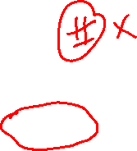
Demonstrating Text Preprocessing
Removal of Special Characters and extra spaces:
this movie made it into one of my top 10 most awful movies horrible there wasn't a continuous minute where there wasn't a fight with one monster or another there was no chance for any character development they were too busy running from one sword fight to another i had no emotional attachment except to the big bad machine that wanted to destroy them
Expanding Contractions:
this movie made it into one of my top 10 most awful movies horrible there was not a continuous minute where there was not a fight with one monster or another there was no chance for any character development they were too busy running from one sword fight to another i had no emotional attachment except to the big bad machine that wanted to destroy them

Slide 22
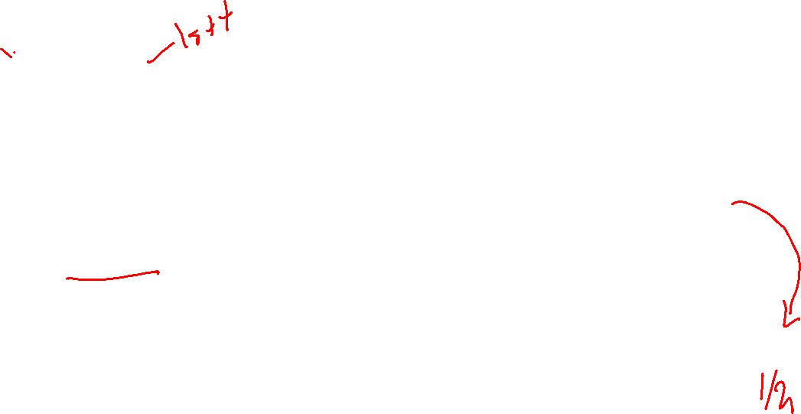
Demonstrating Text Preprocessing
Tokenization:
['this', 'movie', 'made', 'it', 'into', 'one', 'of', 'my', 'top', '10', 'most', 'awful', 'movies', 'horrible', 'there', 'was', 'not', 'a', 'continuous', 'minute', 'where', 'there', 'was', 'not', 'a', 'fight', 'with', 'one', 'monster', 'or', 'another', 'there', 'was', 'no', 'chance', 'for', 'any', 'character', 'development', 'they', 'were', 'too', 'busy', 'running', 'from', 'one', 'sword', 'fight', 'to', 'another', 'i', 'had', 'no', 'emotional', 'attachment', 'except', 'to', 'the', 'big', 'bad', 'machine', 'that', 'wanted', 'to', 'destroy', 'them’]
Removal of stop words:
['movie', 'made', 'one’, 'top', '10', 'awful', 'movies', 'horrible', 'continuous', 'minute', 'fight', 'one', 'monster', 'another', 'chance', 'character', 'development', 'busy', 'running', 'one', 'sword', 'fight', 'another', 'emotional', 'attachment', 'machine', 'destroy']

Slide 23
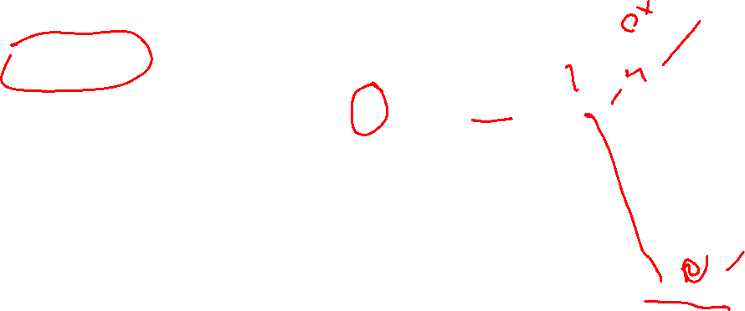
Demonstrating Text Preprocessing
Stemming:
[‘movy', 'mad', 'on’, 'top', ‘ten', 'aw', ‘movy', 'horr', 'continu', 'minut', 'fight', 'on', 'monst', 'anoth', 'chant', 'charact', 'develop', 'busy', 'run', 'on', 'sword', 'fight', 'anoth', 'emot', 'attach', 'mach', 'destroy’]
Lemmatization:
['movie', ‘make', 'one’, 'top', ‘ten', 'awful', 'movies', 'horrible', 'continuous', 'minute', 'fight', 'one', 'monster', 'another', 'chance', 'character', 'development', 'busy', 'run', 'one', 'sword', 'fight', 'another', 'emotional', 'attach', 'machine', 'destroy']

Slide 24
Summary

Slide 25
Project 1a
Define Natural Language Processing
Describe the Challenges of NLP; extraction of meaning from text
Discuss the importance of Natural Language Processing

Slide 26
Q&A

